Slide 1

"Review-I of Major Project”
for E-4 2017
Submitted as part of Major Project.
SRAVANI SARISA - S170062
SK.GRACE JESSY MOON - S171159
PRASANNA NOOLU - S170191
Under the Esteemed Guidance of n of:
S. Sateesh Kumar Asst. Prof
Department of Computer Science and Engineering
Rajiv Gandhi University of Knowledge Technologies
Srikakulam – 532402
‹#›

Slide 2
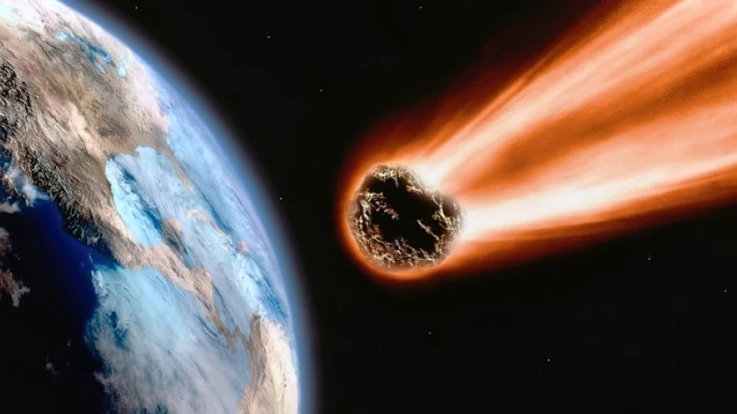
“ NASA Planetoid Stratification Using Supervised Learning Algorithms”

Slide 3

Table of Contents
Introduction
Abstract
Problem Statement
Motivation
Scope
Literature Survey
Challenges
Model Implementations
References

Slide 4

Introduction
Planetoids are leftovers from the formation of our solar system about 4.6 billion years ago.
Generally Planetoids are amorphous.
Most asteroids are located in an area between the orbits of Mars and Jupiter called the Asteroid Belt.
Asteroids helps in finding the characteristics of the solar system.
Why are they located there??????????????????
The gravity of jupiter might have kept a planet from forming in the area.

Slide 5
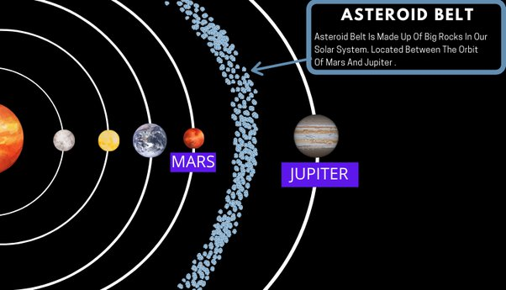

Slide 6
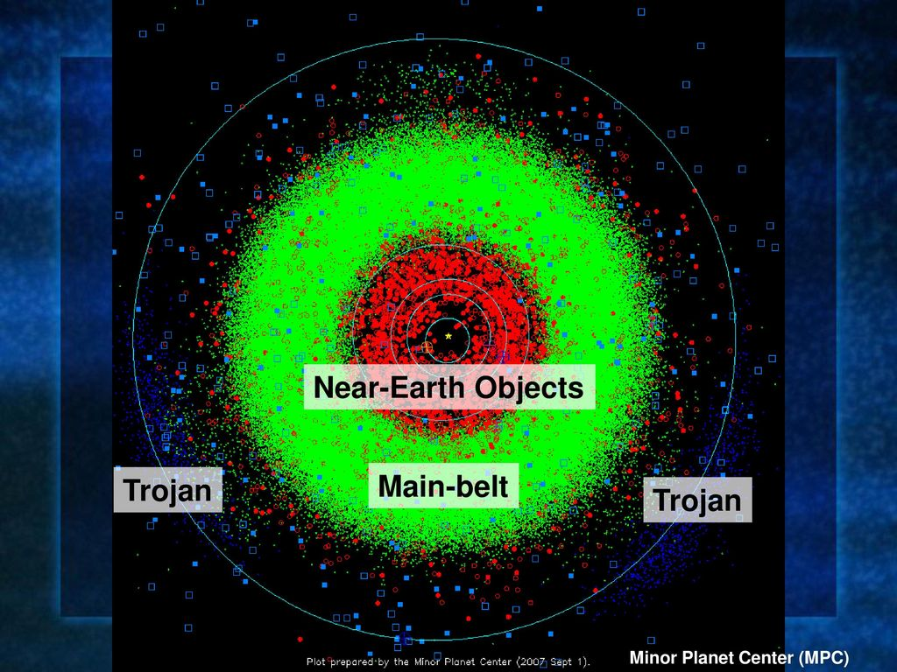
Based on Location
1.Main Belt asteroids
2.Trojan asteroids
3.Near-Earth asteroids

Slide 7
Main-Belt:
between mars & jupiter
non-uniform distribution – kirkwood gaps
Trojan:
out of jupiter orbit
Near - Earth Objects:
over 30,503 asteroids presents
largest 1036 Ganymed 41 KM
99942 Apophis,1993 DA,2062 Aten

Slide 8
How do Planetoids get out of the belts????
Asteroids occasionally leave the trajectory .
Usually this happens in two cases
1.when the gravity of one planet (eg :mars) tends to pull the planetoids towards the inner solar system.
2.when the gravity of one planet (eg: jupiter) tends to pull the planetoids out of the asteroid
belt

Slide 9
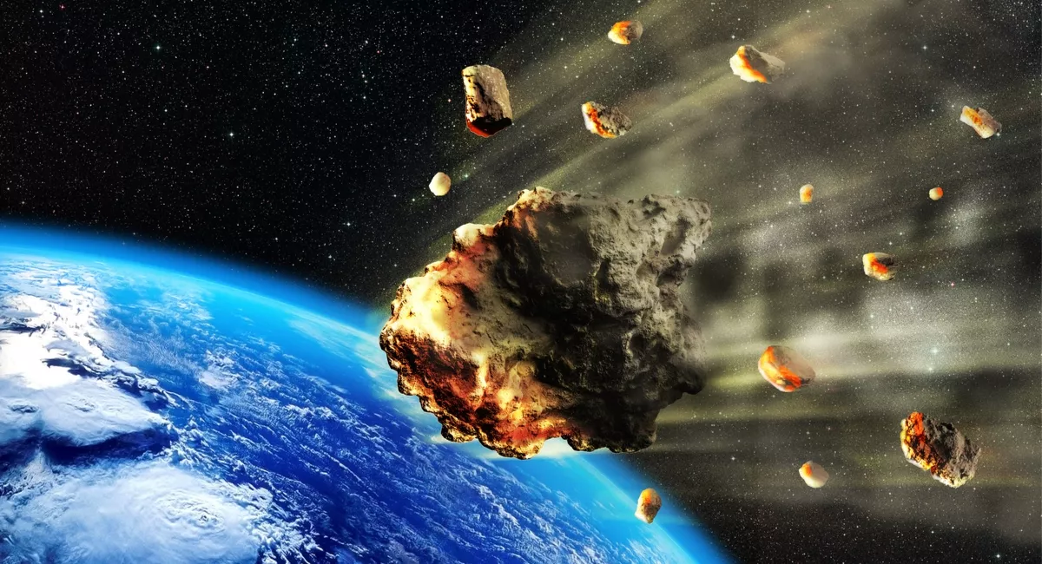

Slide 10
When?????
Asteroid collision will occur when multiple asteroids are escaping from the asteroid belt due to gravity and if they come so close that they cannot escape from each other gravity.
Asteroid collision average impact speed is more than 11,000 miles per hour.
Effects
Asteroid collision leads to formation of shower of debris which means group of pieces of broken bits,stones,etc.
Some other effects like wind blast,over pressure,thermal radiation,tsunamis,extinction of Dinosaurs,etc.

Slide 11
Abstract
Asteroids are leftovers from the formation of our solar system about 4.6 billion years ago. There exist millions of asteroids and the vast majority of known asteroids orbit within the central asteroid belt located between the orbits of mars and jupiter. With an asteroid hitting the Earth ,dust and smoke rising in the atmosphere prevents sunlight from reaching our world and causes the total temperature to drop. This event can lead to the death of many living organisms. The only way to eliminate the threat of the asteroid hitting the earth is to divert them from their course. Many organizations, primarily NASA, performs regular scans of the sky to identify celestial bodies at risk of hitting our earth. But before diverting the asteroid from its path it is much needed to find out whether it is precarious or not. In earlier times astronomers used to use ground-space-based telescopes to detect the threat from celestial bodies. As technology is evolving day by day we want to detect the precarity using machine learning algorithms like Logistic regression, Decision tree, XGBoosting, Random forest.

Slide 12
Motivation of Research Work
The main motivation behind the project is to aid the space research centers.
The idea came out of one of the most fascinating topics where an asteroid crashed the earth millions of years ago, causing the extinction of dinosaurs.
On june 30, 1908, a 40 meter planetoid hit the Tunguska region in siberia. The impact destroyed a london-sized woodland,making it the most influential and most important planetoid impact in recent world history.
The only way to eliminate the threat of the planetoid hitting the earth is to detect them and divert them from their course.

Slide 13
Scope of Research Work
Before diverting the asteroid from its path it is much needed to find out whether it is precarious or not. In earlier times astronomers used to use ground-space-based telescopes to detect the threat from celestial bodies. As technology is evolving day by day we want to detect the precarity using machine learning algorithms.
This type of stratification helps in enhancing the efforts of NASA there by providing more accurate results that helps to prevent the planet from hazardous asteroids.

Slide 14
Literature Survey
From the detailed review of research papers on Planetoid Stratification on different parameters, we gather the information such as
Paper Reference Link
Paper Title ( Author, Year)
Overview of the paper ( Model and Approach)
Dataset used with Statistics
There are many approaches has presented by many researchers.The former approaches which were doing using Logistic Regression Algorithm are not exactly accurate and that’s the reason why astronomers are still using ground-space-based telescopes to detect the threat.
Accuracy we want to train a model with a collection of machine learning algorithms like Decision Tree,Random Forest,XGBoosting etc.
In this process we want to use the dataset collected by NEOWS(Near Earth Object Web Service) consisting of 4687 data instances(rows) and 40(columns) which gives the detailed nature of every asteroid identified by the space research organizations.

Slide 15
Challenges
One of the main challenges in this research is the limited amount of data due to the rare occurrence of large asteroid impacts, as well as uncertainties in the density and strength of different asteroid types.

Slide 16
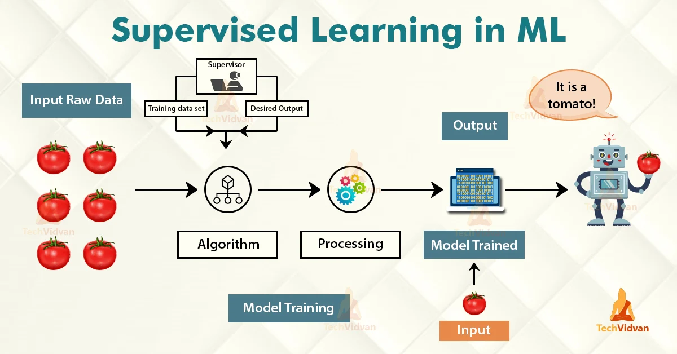
Analysis of Existing Methods/Models/Algorithms

Slide 17
Models
Logistic Regression
Gaussian Naive Bayes
Decision Trees
Support Vector Machine (SVM)
Random Forest
XGBoost

Slide 18
Logistic Regression
Logistic regression is an example of supervised learning. It is used to calculate or predict the probability of a binary (yes/no) event occurring.
In Logistic regression, instead of fitting a regression line, we fit an "S" shaped logistic function, which predicts two maximum values (0 or 1).
The S-form curve is called the Sigmoid function or the logistic function.
In logistic regression, we use the concept of the threshold value, which defines the probability of either 0 or 1. Such as values above the threshold value tends to 1, and a value below the threshold values tends to 0.
from sklearn.linear_model import LogisticRegression

Slide 19


Slide 20

Gaussian Naive Bayes
from sklearn.naive_bayes import GaussianNB
Naïve Bayes theorem is also a supervised algorithm, which is based on Bayes theorem and used to solve classification problems.
It is one of the most simple and effective classification algorithms in Machine Learning which enables us to build various ML models for quick predictions. It is a probabilistic classifier that means it predicts on the basis of probability of an object.

Slide 21
Decision Tree
Decision tree algorithm falls under the category of supervised learning.
They can be used to solve both regression and classification problems.
Decision tree uses the tree representation to solve the problem in which each leaf node corresponds to a class label and attributes are represented on the internal node of the tree.
from sklearn.tree import DecisionTreeClassifier as DTC

Slide 22
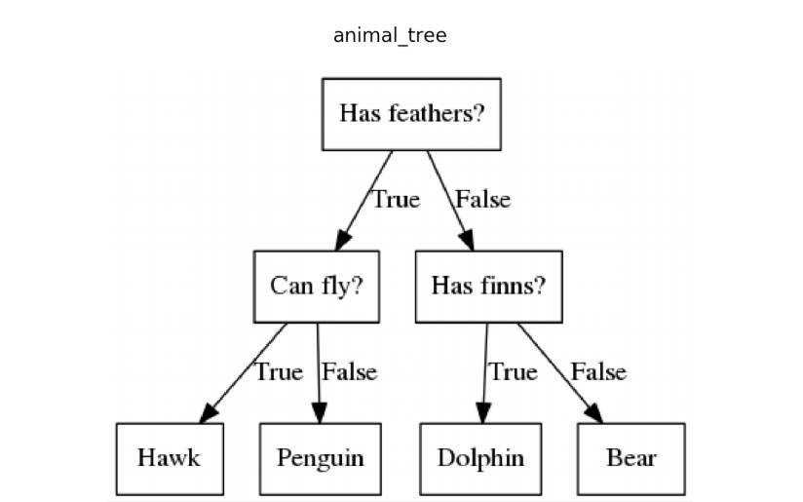

Slide 23
Support Vector Machine
Support Vector Machine or SVM is one of the most popular Supervised Learning algorithms, which is used for Classification as well as Regression problems. However, primarily, it is used for Classification problems in Machine Learning.
The goal of the SVM algorithm is to create the best line or decision boundary that can segregate n-dimensional space into classes so that we can easily put the new data point in the correct category in the future.
This best decision boundary is called a hyperplane.
from sklearn.svm import SVC # "Support vector classifier"

Slide 24


Slide 25
Random Forest
Random Forest is a popular machine learning algorithm that belongs to the supervised learning technique.
It can be used for both Classification and Regression problems in ML.
It is based on the concept of ensemble learning, which is a process of combining multiple classifiers to solve a complex problem and to improve the performance of the model.
"Random Forest is a classifier that contains a number of decision trees on various subsets of the given dataset and takes the average to improve the predictive accuracy of that dataset."
The greater number of trees in the forest leads to higher accuracy and prevents the problem of overfitting.

Slide 26
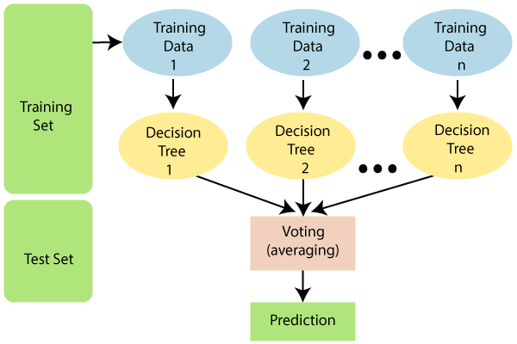

Slide 27
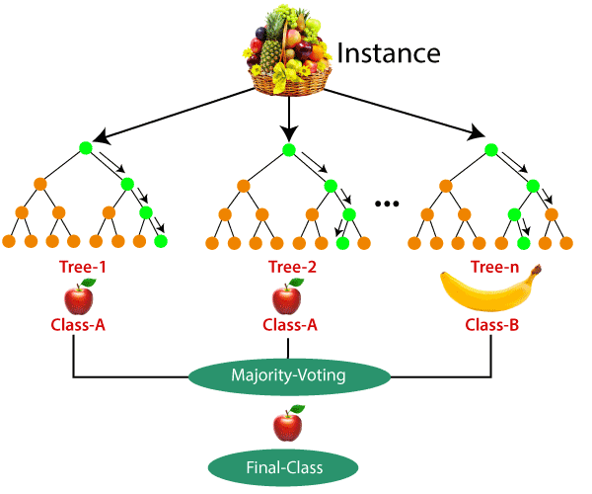

Slide 28
XGBoost
XGBoost builds one tree at a time so that each data pertaining to the decision tree is taken into account and the data is filled if there are any missing data. This helps developers to work with gradient algorithms along with the decision tree algorithm for better results.
If we want to explore more about decision trees and gradients, XGBoost is good option.
from xgboost import XGBClassifier

Slide 29
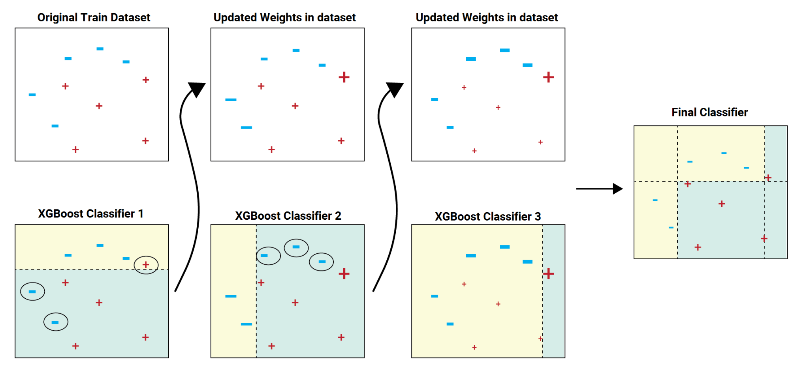

Slide 30
Neural Networks
Neural networks are a set of algorithms, modeled loosely after the human brain, that are designed to recognize patterns.
They interpret sensory data through a kind of machine perception, labeling or clustering raw input. The patterns they recognize are numerical, contained in vectors, into which all real-world data, be it images, sound, text or time series, must be translated.
ANN replicates a biological neuron. Input to a neuron - input layer, Neuron - hidden layer, Output to the next neuron - output layer.

Slide 31
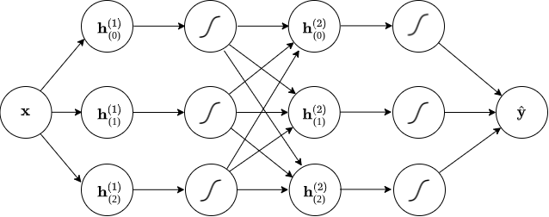

Slide 32
RESULTS

Slide 33
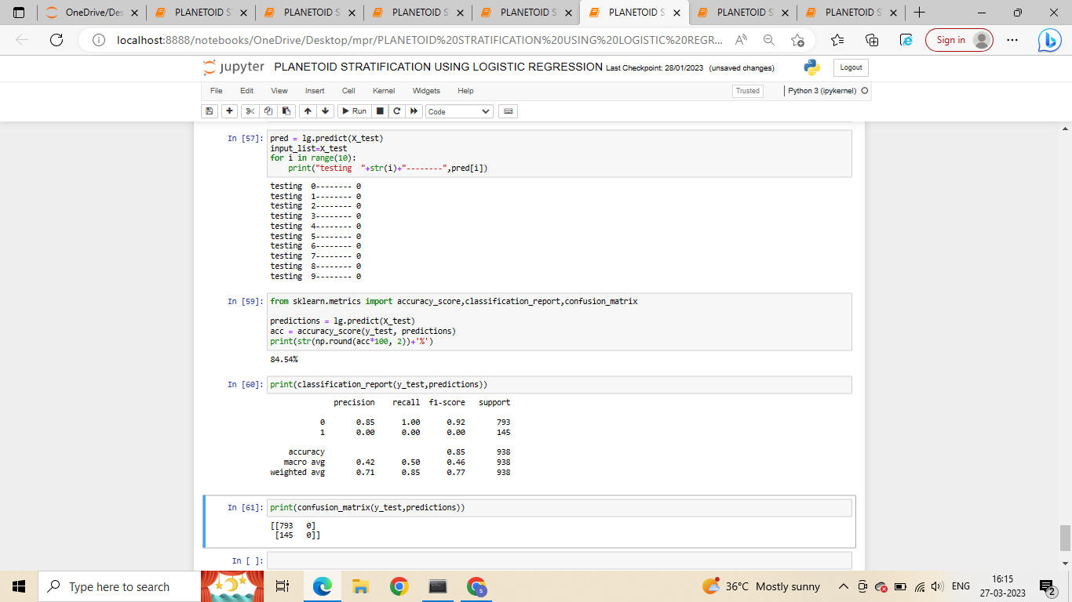
1.Logistic Regression

Slide 34
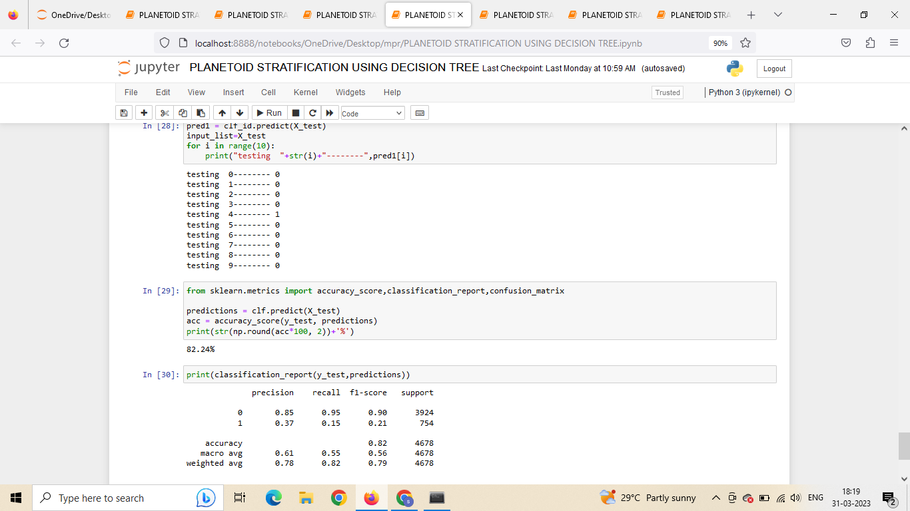
2.Decision Tree

Slide 35
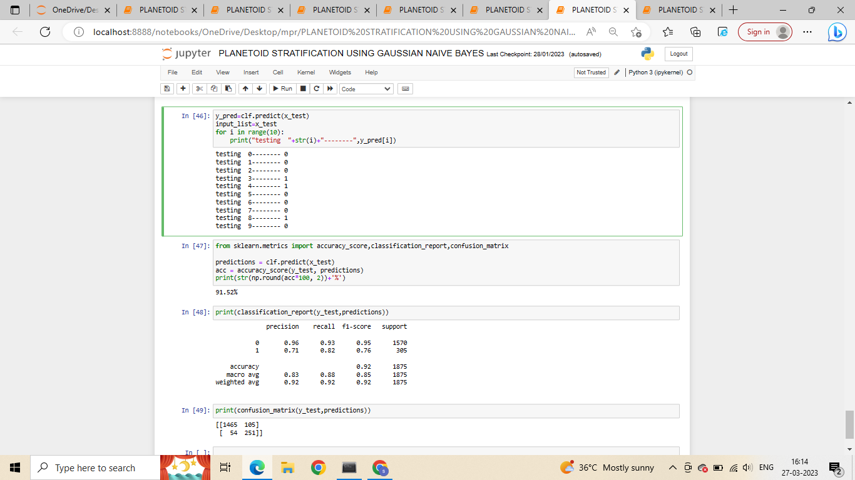
3.Gaussian Naive Bayes

Slide 36
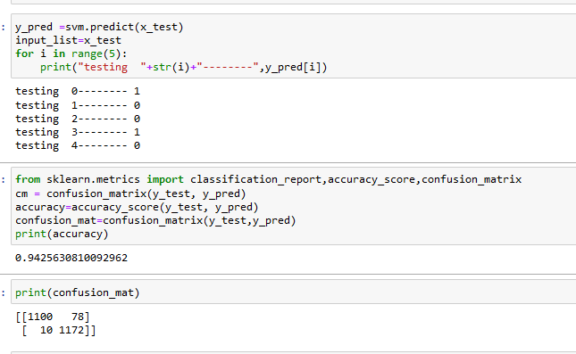
4.Support Vector Machine
.

Slide 37
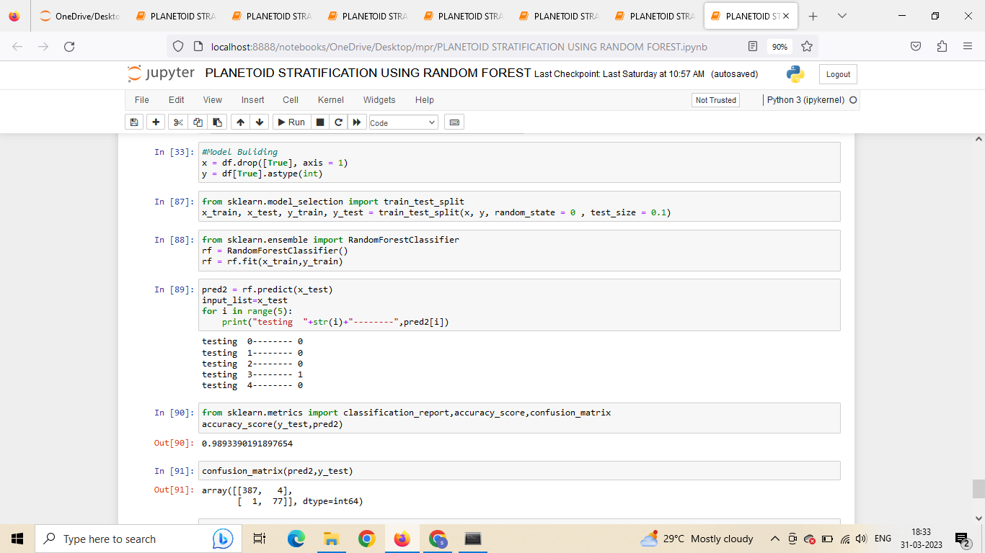
5.Random Forest

Slide 38
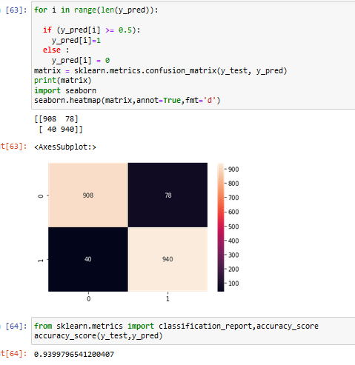
6.Neural Networks
.

Slide 39
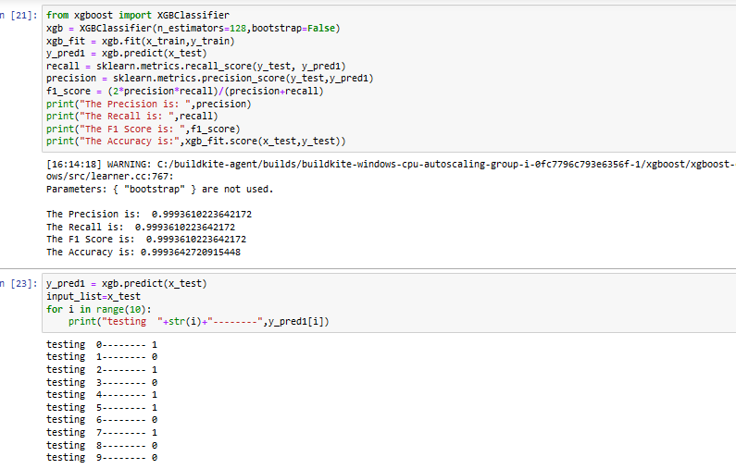
7.XGBOOST

Slide 40
Conclusion & Future Work
In this project, we have built a Machine learning model which can show the probability value of a planet(earth) that may be hit by an asteroid. Based on the data we have collected from the space research center , we have classified whether the asteroid is precarious or not. At the end we have classified whether the asteroid is hazardous or not . These values may change in the future according to asteroid revolving actions or based on the technology growth . The model which predicts low accuracy, may have high accuracy in the future and vice versa . So, our model needs continuous data to get the inputs on a daily basis. In the future , based on the continuous data we get from the space research center, we will build software which can be used by the researchers for predicting the characteristics of an asteroid. That software will collect the data from the research center continuously, so our model which is implemented in that software will show the predicted probability and then the researchers can perform actions according to the output.

Slide 41
References
1)https://ieeexplore.ieee.org/document/9697222
2)https://ieeexplore.ieee.org/document/9753945
3)https://www.aanda.org/articles/aa/full_html/2021/05/aa38545-20/aa38545-20.html
4)https://towardsdatascience.com/nasa-asteroid-classification-6949bda3b1da

Slide 42
Thank You

